Slide 1
Customer and Product Analysis using SQL

Slide 2
Goals
Analyse data from a sales records database for scale model cars, extracting information for decision-making.
DB browser for SQLite is used for this project on a local PC.
Key business questions to be answered:
Which products should we order more or less of?
How should we tailor marketing and communication strategies to customer behaviours?
How much can we spend on customer acquisition?

Slide 3
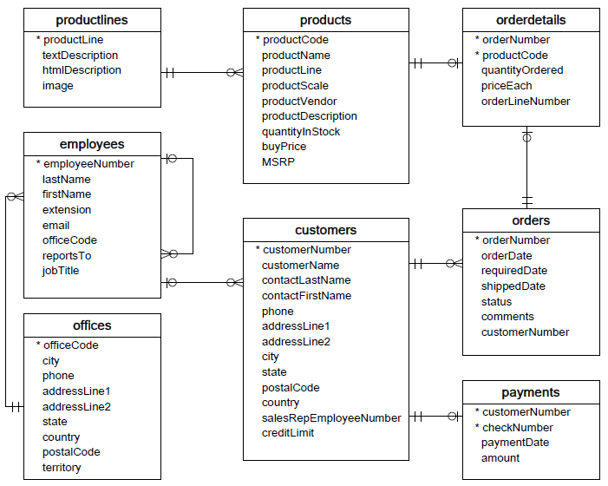
Database Schema
The relational database contains 8 tables:
Customers (links to orders, payments, employees)
Employees (linked to itself, customers and offices)
Offices (linked to employees)
Orders (linked to customers and orderdetails)
OrderDetails (linked to orders and products)
Payments (linked to customers)
Products (linked to orderdetails and productlines)
ProductLines (linked to products)

Slide 4
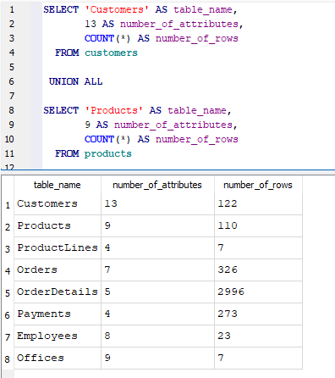
Tables Summary
A summary of all fields (attributes) and records found across all tables in the database is first generated using the UNION ALL compound operator to bind SELECT statements for each table.
Customers: 122 unique customers (key fields include company name, contact first and last name, contact number, address, sales rep employee number and credit limit information)
Products: 110 unique products (key fields include product name, description, productline, scale of the model car, quantity in stock, buyprice, MSRP [manufacturer suggested retail price])
ProductLines: 7 categories of product type (key fields include category name and a text description of products in that category)
Orders: 326 processed orders (key fields include order date, required date, shipping date, status, comments and customer number)
OrderDetails: 2996 instances of a product being ordered across all orders (key fields include order number, product code, quantity ordered, price per unit)
Payments: 273 payments received (key fields include customer number, cheque number, payment date and amount)
Employees: 23 employees (key fields include employee number, first, last name, email, officecode, reportsto, jobtitle)
Offices: 7 offices (key fields include city, phone, address lines, state, country, post code, territory)

Slide 5
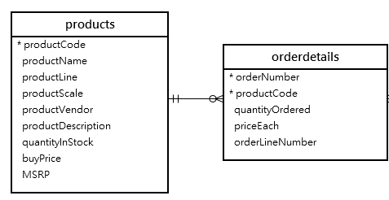

Question 1: Which products should be ordered more of or less of?
To give us the necessary information to answer this question effectively, we must first define a KPI to help identify priority products (those which perform best by bringing in high sales and are low in stock).
Product performance can simply be defined as the sum of sales a product brings in.
Low stock can be defined by taking the sum of all instances where a product has been ordered and divide this by the quantity of the same product left in stock. A greater stock index indicates a product that is in low stock.
$$Product performance=Sum(quantityOrdered×priceEach)$$
$$Stock index= \frac{Sum(quantityOrdered)}{quantityInStock}$$

Slide 6
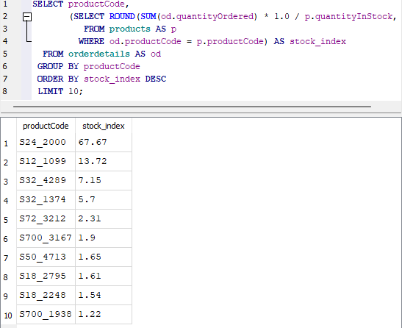
Question 1: Which products should be ordered more of or less of?
Low stock can be defined using a metric aliased here as ‘stock_index’. A correlated subquery is used to calculate the top 10 products in the database with the highest index values.
Higher values indicate products that have been ordered a large amount relative to the amount remaining in stock

Slide 7
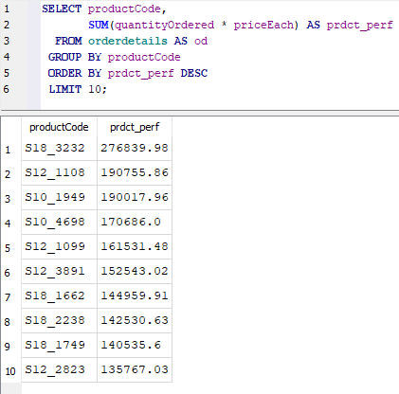
Question 1: Which products should be ordered more of or less of?
Product performance can be defined using a metric aliased here as prdct_perf. The top 10 products in the database with the greatest performance are listed.
Higher values indicate products that are most valuable to the company by bringing in the most sales.

Slide 8
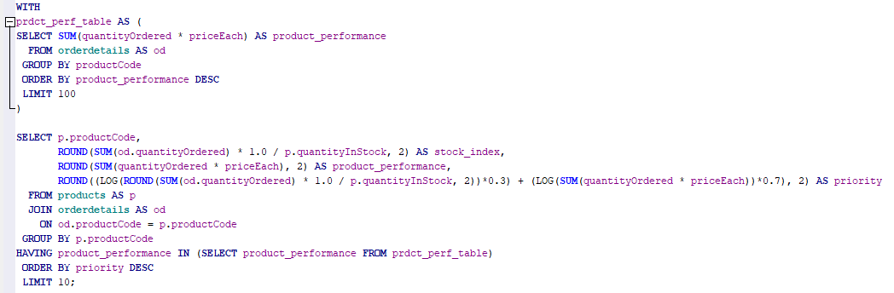
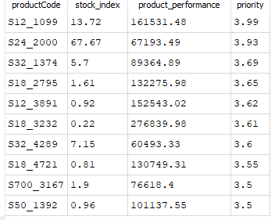
Question 1: Which products should be ordered more of or less of?
The final query here utilises a CTE to combine the top 10 products (those with the greatest product performance) with an outer query that returns the stock index of each product in the top 10 highest performing products, and each’s associated priority of restocking. The derived field named priority is defined by taking the sum of the logs of product_performance and stock_index value. Higher values of priority indicate products that should be restocked first.
Weights have also been introduced into the calculation so that higher performing products will be favoured in the priority calculation - here, performance contributes 70% to the overall priority value while stock index contributes 30%. These weights can be altered depending on whether the company would prefer to ensure the most profitable products are restocked first or if the company would prefer the lowest stocked items to be restocked before anything else

Slide 9
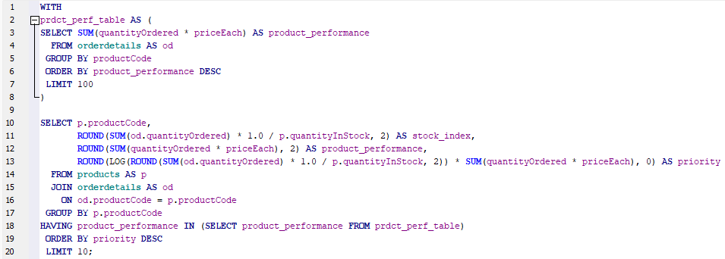
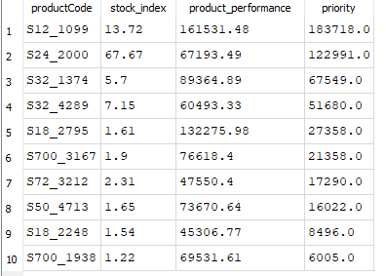
Question 1: Which products should be ordered more of or less of?
For a more comprehensive list of products, the limit on the prdct_per_table CTE can be raised (e.g., the top 100 best performing products). This alters the result, indicating that other products that lie outside of the top 10 highest performers are worth restocking.
Looking at the numbers, products with large stock_indexes (generally greater than 1) are high on the priority list for restocking (especially those greater than 5). It is important to note that the priority field is by no means a perfect measure of priority – it is only a simple number that combines two factors. A better model of stock priority could be defined using a different mathematical definition (e.g., adding weights to factors depending on their importance or to include additional factors).

Slide 10
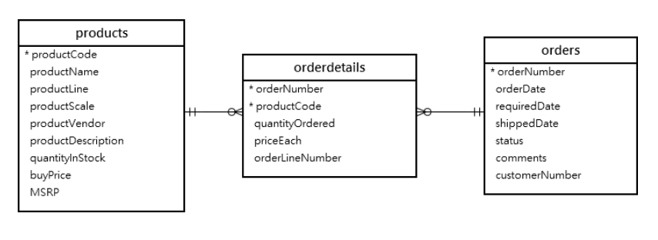
Question 2: How should we match marketing and communication strategies to customer behaviour?
This is essentially a question of categorising customers into those which are highly valuable (VIPs) to the company, who we can make a lot of sales to, and those which are less engaged. By categorizing customers in this way, we can then think about organizing loyalty events for the identified VIP customers and holding campaigns to target and drive-up engagement for the less profitable customer base.
To begin, we can first look to calculate the profit made from each customer in the database.

Slide 11
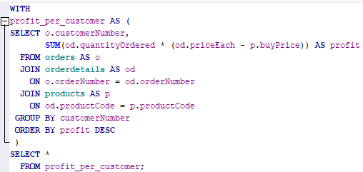
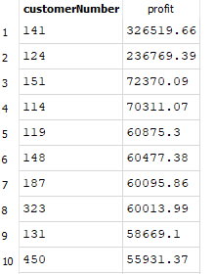
Question 2: How should we match marketing and communication strategies to customer behaviour?
A query is first written to generate a table ‘profit per customer’. A CTE is utilised here to refer to the generated table rather than simply using a subquery as tables (improved legibility and reusability). The resultant table lists profit for every customer in the database that has purchased at least one item.

Slide 12
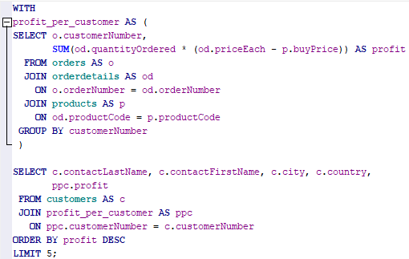
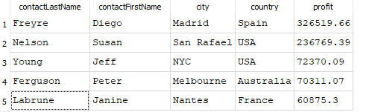
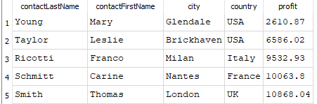
Question 2: How should we match marketing and communication strategies to customer behaviour?
To output key information on the top 5 most profitable customers (and bottom 5), a further query is written joining the profit_per_customer CTE to the customers table. Ordering instead by profit in ascending order, we can view the least profitable customers.
Top 5
Bottom 5

Slide 13
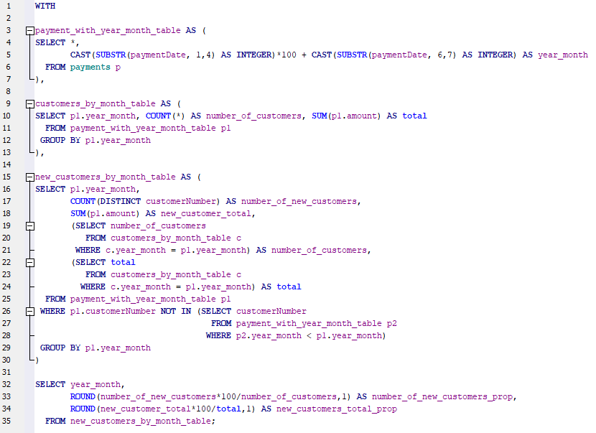
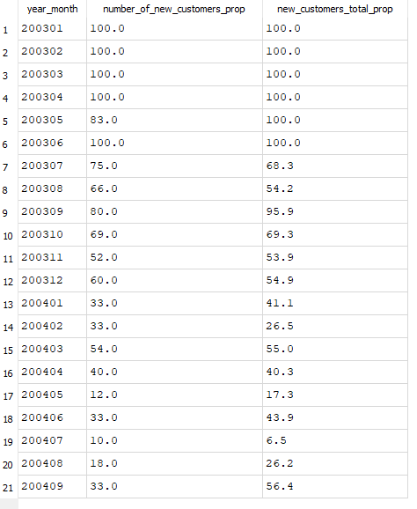
Question 3: How much can we spend on customer acquisition?
Before answering this question, it is important to first establish whether it is even worth spending money on acquiring new customers. To do this, a query is written to calculate the proportion of new customers and the proportion of total payments made by new customers each month:

Slide 14
Question 3: How much can we spend on customer acquisition?
These results show there is a need to acquire new customers for the health of the business. The proportion of new clients (number_of_new_customers_prop) has been decreasing since 2003 with all-time low values of new clients towards the end of 2004.
We can also see the proportion of sales contributed by new customers each month (new_customers_total_prop) has also been declining, though is variable.
It is also important to note that data for 2005 is included in the database, so the fact it doesn’t appear in this output indicates that there have been no new clients since September 2004.

Slide 15
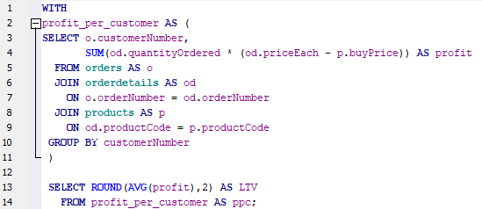

Question 3: How much can we spend on customer acquisition?
Using the profit_per_customer CTE we generated previously, we can find the Customer Lifetime Value (LTV) which represents the average amount of money a customer will generate for the company:
This simple metric tells us an average customer brings in around $39,000 in profits for the business, meaning on average for every 26 new customers acquired, we can expect profits of $1 million (provided the new customers are like the existing clients in the database).
This information enables informed decision making for marketing budgets.

Slide 16
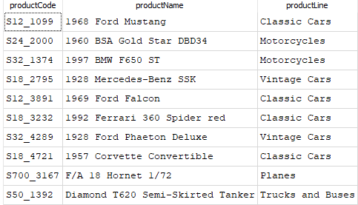
Conclusions
Key findings:
The products listed (right) are good candidates for restocking first. These are typically products in the classic/vintage car and motorcycle product lines. Note also, the priority calculation could be modified by changing the weighting of each factor if the business would like to change the restocking strategy.
The top 5 and bottom 5 customers by profit have been identified, enabling informed decisions to be made when planning future customer loyalty events or targeted ad campaigns.
The customer average Lifetime Value (LTV) was determined to be $39K – the average amount of profit expected from a typical client over the course of their time spent making purchases. Projections suggest that on average for every 26 new customers acquired, we can expect additional profits of $1 million.
Top 5
Bottom 5

